Slide 1
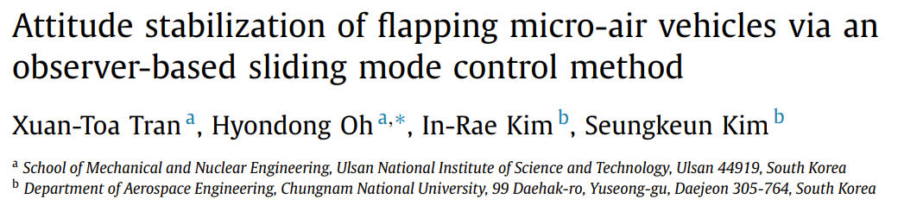
Notes for enae743 proj
Using NEW paper:

Slide 2
Goal: attitude stabilization of flapping micro-aerial vehicle. Example Simulink model below
d(t)
Plant Dynamics (eqns 1):
Input: u, d(t), q, w
Output: qdot, wdot
Fig 6
Controller (eqns 2):
Input: q, w
Output: u
qdot, wdot
Integrator
q, w
u
Euler angles
Fig 6
q, w
q, w
Phi, psi, alpha
Wing input angles (eqs3)
Fig 7, 8

Slide 3
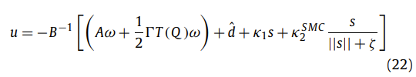
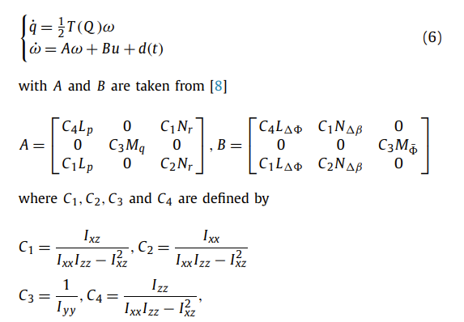
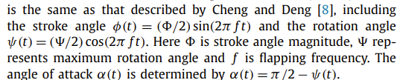
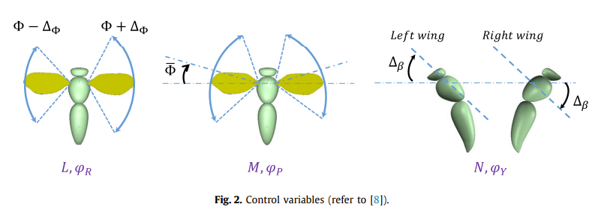
Equations
Equations 2
Equations 1
Equations 3

Slide 4
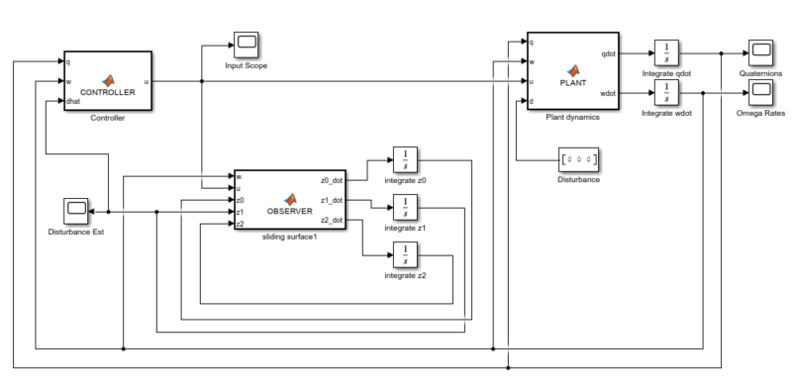
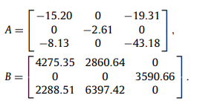



Implementation: 11 APR 24
PLANT Eqns

Slide 5
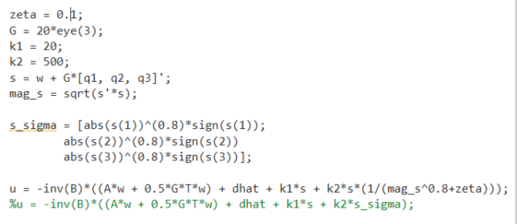
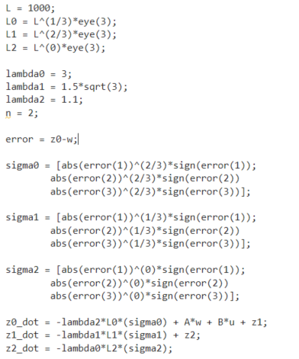
CONTROLLER Eqns
OBSERVER Eqns
Follows eqn (22) using the prev slides definitions as well
Follows eqn (7) using the prev slides definitions as well

Slide 6
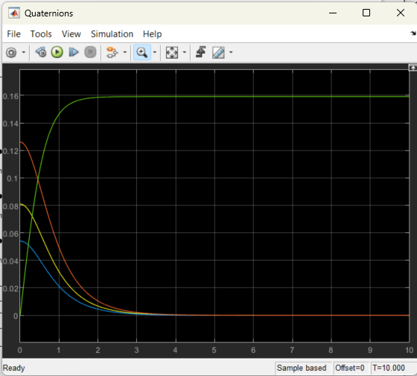
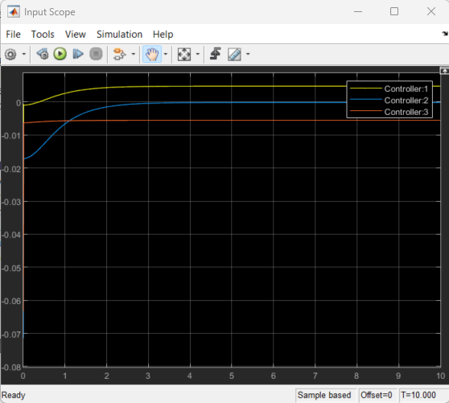
Implementation: 11 APR 24 Results
It’s converging the quaternions to 0 and the observer is recreating the disturbance.
Some issues though: it’s converging ~10x slower than the paper reports it should. I’m not at all sure why.

Slide 7
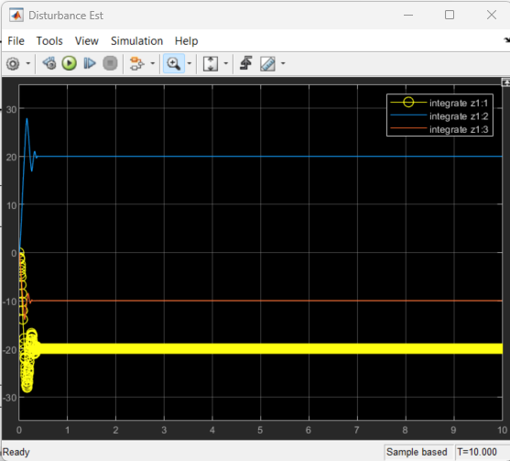
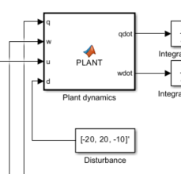
Implementation: 11 APR 24 Results
It’s converging the quaternions to 0 and the observer is recreating the disturbance.
Some issues though: it’s converging ~10x slower than the paper reports it should. I’m not at all sure why.

Slide 8
Implementation: 11 APR 24 Results
TO DO (in order of importance):
Diagnose why it’s converging 10x slower
Go to the paper and see if we can estimate the convergence rate: NOTE, cap Lambda (in paper) seems to control convergence rate!!!
See if there’s an incorrectly assigned exponent
Resolution: In short, I don’t really care. We can fix it by correcting cap Lambda, so it doesn’t matter much to me
NOTE 2: in the 19FEB24 euler angles model, this is fixed! IDK Why, but it seems like when doing the work in phi-space it fixed it.
There should also be a slight bias to a q value from the disturbance. Try and diagnose that too.
Resolution: Ours doesn’t show a slight bias, and I’m generally OK with that
Convert from quaternions to Euler angles – should be a simple transformation and be independent of stability/system performance
I performed the control over the euler angles themselves and that seemed to work just as fine
Convert inputs to actual hovering inputs
DONE!
Try more complicated disturbance dynamics
Done, added some noise!

Slide 9
Implementation: 19 APR 24 Results
Changes made:
Added in complex disturbance model
Wrote the program in euler angles themselves rather than quarternions
Now added hovering outputs
Used a sat-input and tuned to avoid
To Do:
Math to demonstrate stability
Math to demonstrate disturbance convergence
Math boundary layer analysis
Go thru and check if there are other things we need to prove
Then write everything up for project check-in

